Slide 1

What are MindMate Lessons? KS4
© Leeds South and East CCG
Notes:
This introduction can be used either as an assembly or as a lesson. There is a very similar Powerpoint for KS3 which may also be used in both ways. Please select the one which feels most appropriate for you students.
If you are using it as an introductory lesson use the guidelines slide (3) as an opportunity to draw up guidelines for the rest of the MindMate lessons. If using as an assembly hen use the guidelines slide to explain that you will be using guidelines in the lessons to ensure that pupils treat each other well and are kept safe.

Slide 2

What is MindMate
MindMate is about:
how we feel and what we do
improving our mental health and wellbeing
supporting other people
Notes:
When you open the slide allow time for the liquid in the thermometer to go up and down and the emojis change.

Slide 3
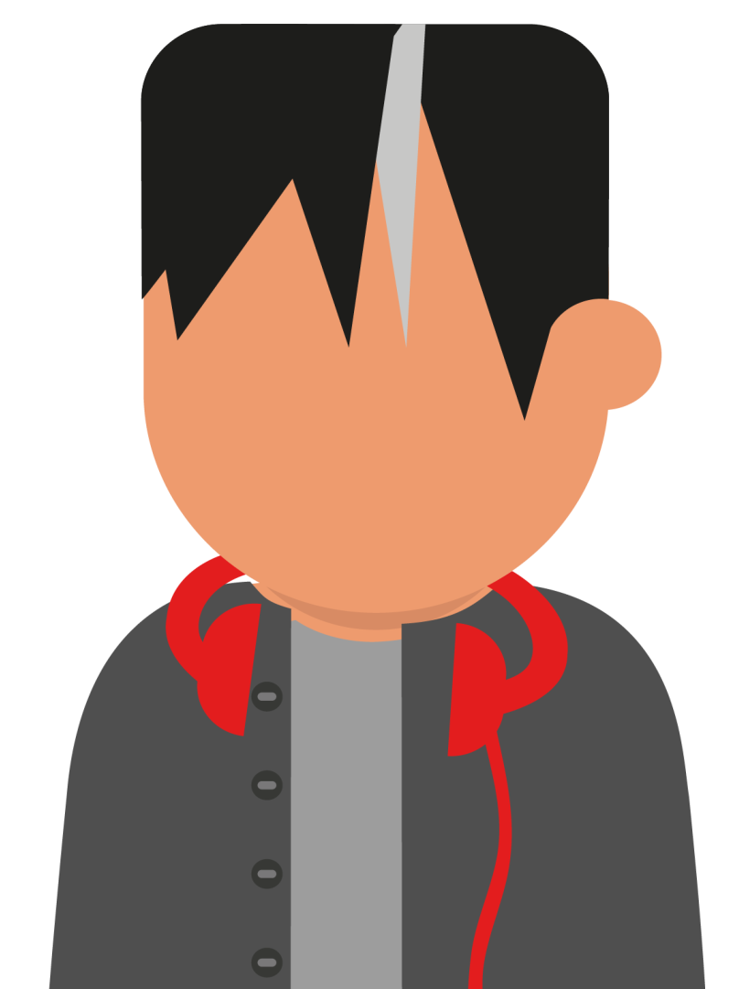
How we will work together
Can you remember the ground rules we have already talked about, let’s take a minute to think about them.
3
Notes:
If using in an assembly you might wish to remind pupils of the concept of ground rules and suggest that whilst you would normally agree them together you will use some of the most common ones to save time. Something along the lines of “All pupils will be respectful to other pupils and not share what they have told them unless they have permission.”
If you are using the slides as an introductory lesson then draw up the class guidelines here. There are notes on this in the guidance. A great starting place is to make a connection between how we would like to feel in the lessons and how we will behave to do this. Pupils may need some prompting and some encouragement to explore feelings and behaviours and to be clear about the difference between the two.
Record the ground rules on a piece of paper or add a slide which can then be copied into all the MindMate Lessons so that they are to hand in the lessons as a reminder and to add to if necessary.

Slide 4

Wellbeing: Naming it
What kind of things do these words describe?
happy sad angry mean excited frustrated panicky resilient joyful calm anxious depressed comfortable

Slide 5


Feelings words
Pair up
Pick a word and tell the person next to you when you might feel like this
Decide together whether the feeling is comfortable uncomfortable
Now think about other feelings words; are they are comfortable or uncomfortable feelings?
Notes:
The idea here is to both explore the feelings and also to remind pupils that feelings aren't good/positive or bad/negative, sometimes it is appropriate to feel sad, angry etc. If we label feelings in a more neutral way it will support pupils to talk more openly about a range of feelings.

Slide 6






What do these people have in common?
Notes:
Answer they have all talked openly about their mental health problems. They have all succeeded in life in spite of their mental health problems

Slide 7

What is mental health?
If we are mentally healthy are we happy all the time?
No sometimes we need to feel uncomfortable feelings
What happens if our uncomfortable feelings are there all the time?
This is when we could have mental health problems
How common are mental health problems?
1 in 4 adults will have a mental health problem at some time in their life
Can you name any mental health problems?
2 common mental health problems are depression and anxiety

Slide 8
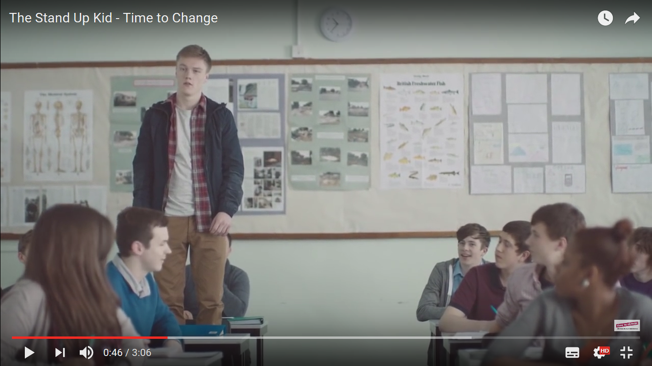
Time for change
Notes:
This video is taken from the Time for Change anti-stigma campaign. It has been edited to start at 25sec to avoid possible offense. For this reason it is not embedded but hyperlinked through to youtube.

Slide 9

What helps when someone has strong and uncomfortable feelings?
Pair up and see if you can come up with 4 ideas (some of them were mentioned in the film)
Talking to friends and family
Talking to a trusted adult
Writing down how they feel
Being active and eating well
Changing the way we think
Talking therapies
Remembering that the feeling will pass
Breathe through panic
MindMate and MindMate lessons
Notes:
The ideas will appear when the slide is clicked on for a second time. Allow pupils to come up with their won suggestions before showing them.

Slide 10
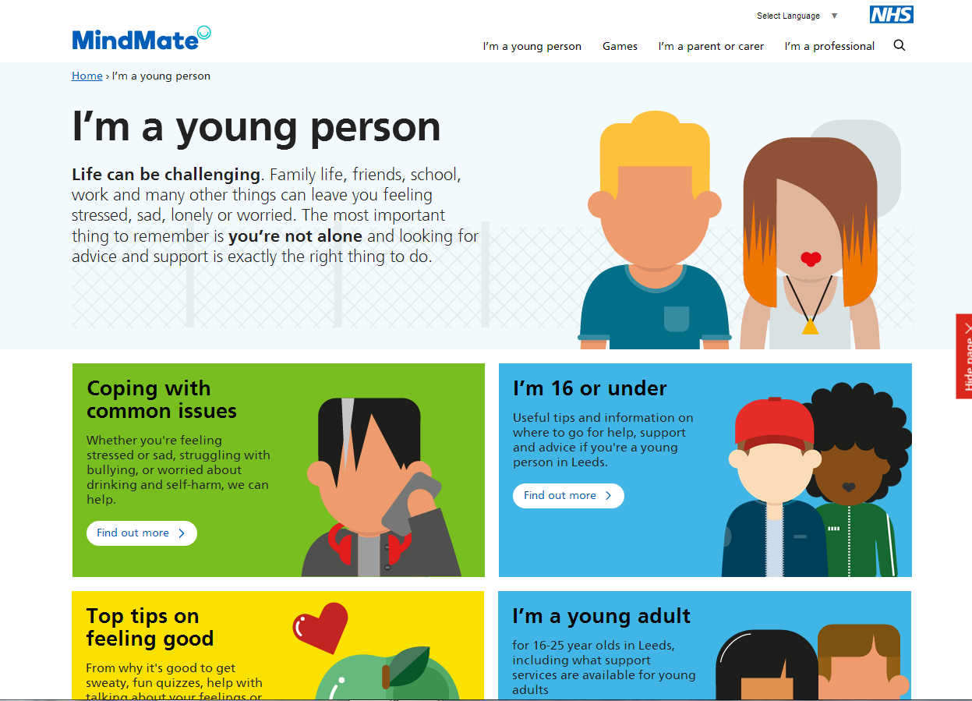
MindMate help
Notes:
The MindMate website is somewhere young people can go to find out more about mental health and wellbeing, including top tips and local services. Open the hyperlink if time allows to show them what the site is like.

Slide 11
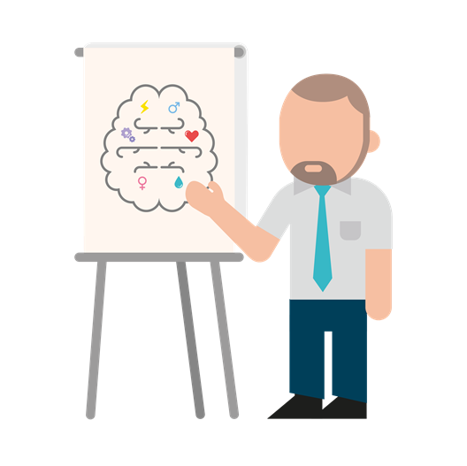
How will the lessons help?
They will teach skills to help you look after yourself and support your friends
They will explain life changes and healthy relationships
They will help you to see what you are good at and set goals
Notes:
These are just some of the benefits of the MindMate Lessons. Remind pupils that even if they don’t personally need help their friends and family may do so either now or in the future.

Slide 12

Why is it important to have good mental health?
It can help with
Coping with difficult situations and life changes
Doing well at school
Making and keeping friends
Doing well at sports and hobbies

Slide 13

Talking is often the first step
Notes:
Freddie Flintoff and Poressor Green tell us how things have been improved for them by talking about their mental health. Cautionary note Professor Green talks about his Dad taking his own life. You may need to forewarn vulnerable pupils (e.g. those who have had a similar experience) about this

Slide 14

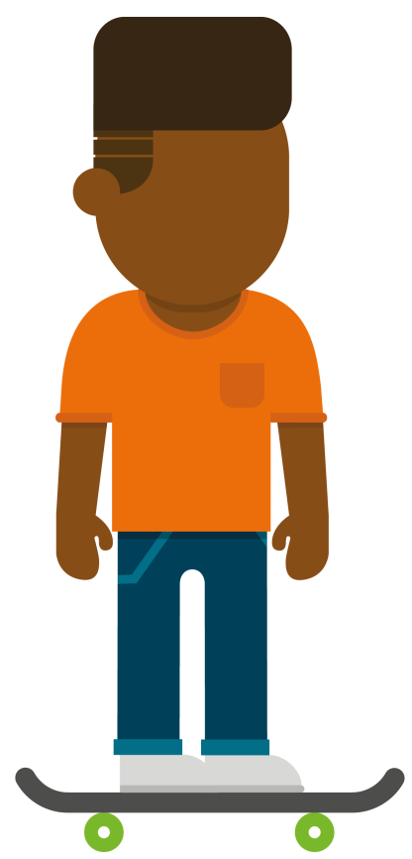
Taking the learning away
Take a look at the MindMate website
Play one of the games on the website
Show it to one of the adults in your life
Tell them about the MindMate Lessons
14
Notes:
https://www.mindmate.org.uk/games/

Slide 15
Who can help with wellbeing and mental health in school?
Notes:
Complete for your school

Slide 16

Want to know more or get help?
www.mindmate.org.uk/ im-a-young-person
www.childline.org.uk/ get-support
Contact:
Call, email or go online
16

Slide 17
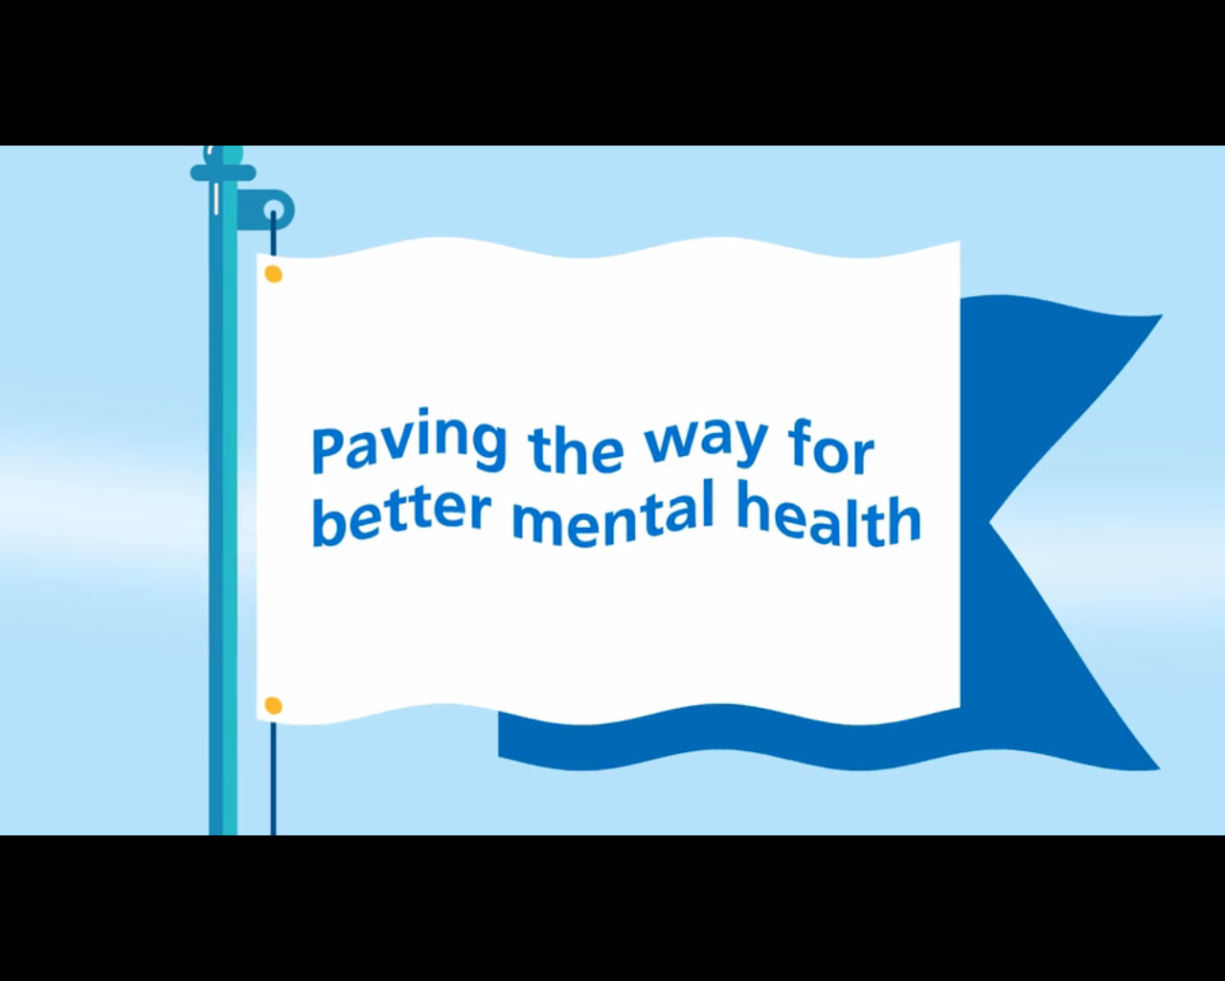
MindMate Lessons

