Slide 1

What are MindMate Lessons
KS2?
© Leeds South and East CCG
Notes:
This Powerpoint can be used as an introductory lesson or as an assembly. There is a very similar Powerpoint for KS1 which may also be used in both ways. Please select the one which feels most appropriate for you students. If you are using as an introductory lesson use slide 10 to develop the class ground rules for these lessons. If using as an assembly it is simply an opportunity to explain there will be ground rules and what they are.

Slide 2

What is MindMate
MindMate is about:
how we feel and
what we do
improving our mental health and wellbeing
Notes:
When you open the slide allow time for the liquid in the thermometer to go up and down and the emojis change.

Slide 3

Wellbeing: Naming it
What kind of things do these words describe?
happy sad angry mean excited frustrated angry joyful calm comfortable

Slide 4


Feelings words
Pair up
Pick a word and tell the person next to you when you might feel like this
Decide together whether the feeling is comfortable uncomfortable
Now look at the other words and decide if they are comfortable or uncomfortable

Slide 5

What is mental health?
If we are mentally healthy are we happy all the time?
No sometimes we need to feel uncomfortable feelings
What happens if our uncomfortable feelings are there all the time?
This is when we could have mental health problems
How common are mental health problems?
1 in 4 adults will have a mental health problem at some time in their life
Can you name any mental health problems?
2 common mental health problems are depression and anxiety

Slide 6

What helps when someone has strong and uncomfortable feelings?
Some ideas
Talking to friends
Talking to an adult
Writing down how they feel
Being active
Talking to their doctor
Remembering that the feeling will pass

Slide 7
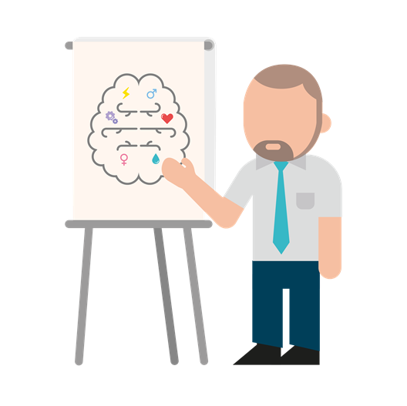
How will the lessons help?
They will teach skills to help you look after yourself and support your friends
They will explain life changes and healthy relationships
They will help you to see what you are good and set goals

Slide 8

What will we do in the lessons?
Watch videos
Talk in pairs
Learn about our feelings
Learn how to help other people

Slide 9

Let’s have a look
Notes:
This is an example of the type of resource used in the lessons. This is a video from the Huffington Post aimed at reducing stigma around mental health.

Slide 10
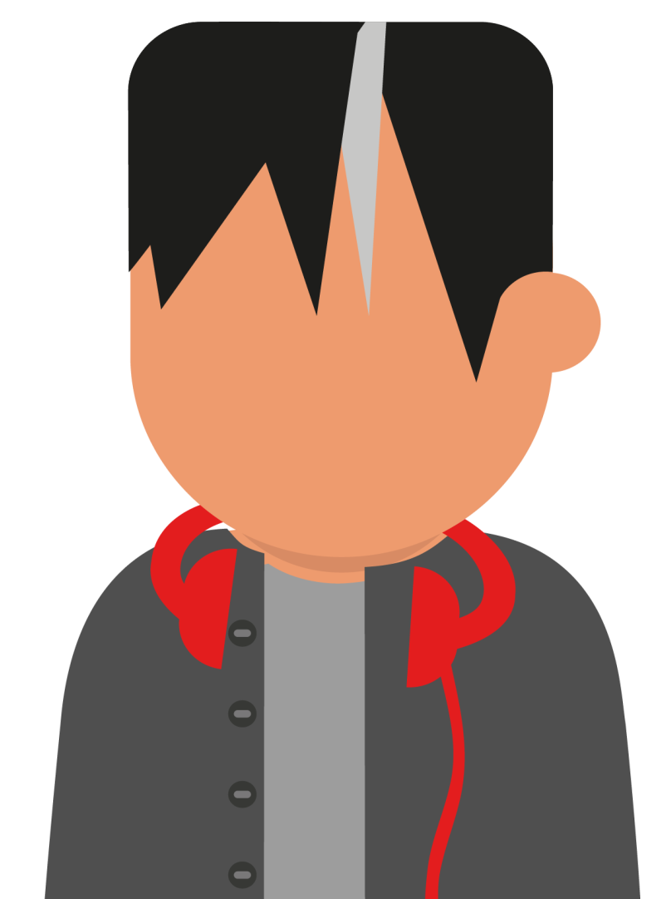
How we will work together
Can you remember
the ground rules
we have already
talked about, let’s
take a minute to
think about them.
10
Notes:
If using in an assembly you might wish to remind pupils of the concept of ground rules and suggest that whilst you would normally agree them together you will use some of the most common ones to save time. Something along the lines of “All pupils will be respectful to other pupils and not share what they have told them unless they have permission.”
If you are using the slides as an introductory lesson then draw up the class guidelines here. There are notes on this in the guidance. A great starting place is to make a connection between how we would like to feel in the lessons and how we will behave to do this. Pupils may need some prompting and some encouragement to explore feelings and behaviours and to be clear about the difference between the two.
Record the ground rules on a piece of paper or add a slide which can then be copied into all the MindMate Lessons so that they are to hand in the lessons as a reminder and to add to if necessary.

Slide 11

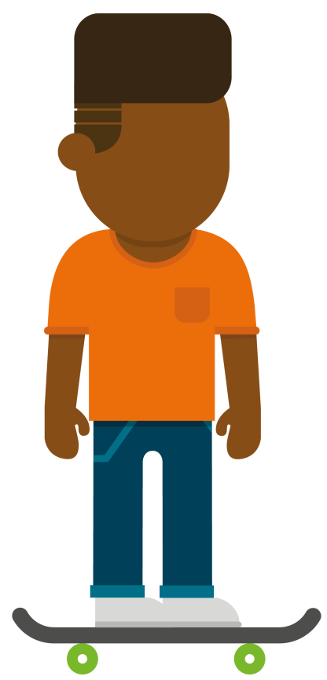
Taking the learning away
When you watch TV or read a book think about the characters feelings
See how many feelings you can spot
Tell your family that you are going to be learning more about this kind of thing in your MindMate lessons.
11

Slide 12

Additional resources and help
Talk to your teacher or an adult in school
Talk to your Mum, Dad or someone you trust at home about how you are feeling
If you have them:
– Write your worry down and post it in
the class worry box
– Talk to a peer mediator in your school
– Write your worry down on the worry
wall on the school’s website
Contact:
www.mindmate.org.uk/
im-a-young-person
Where can I go for help?
12

Slide 13
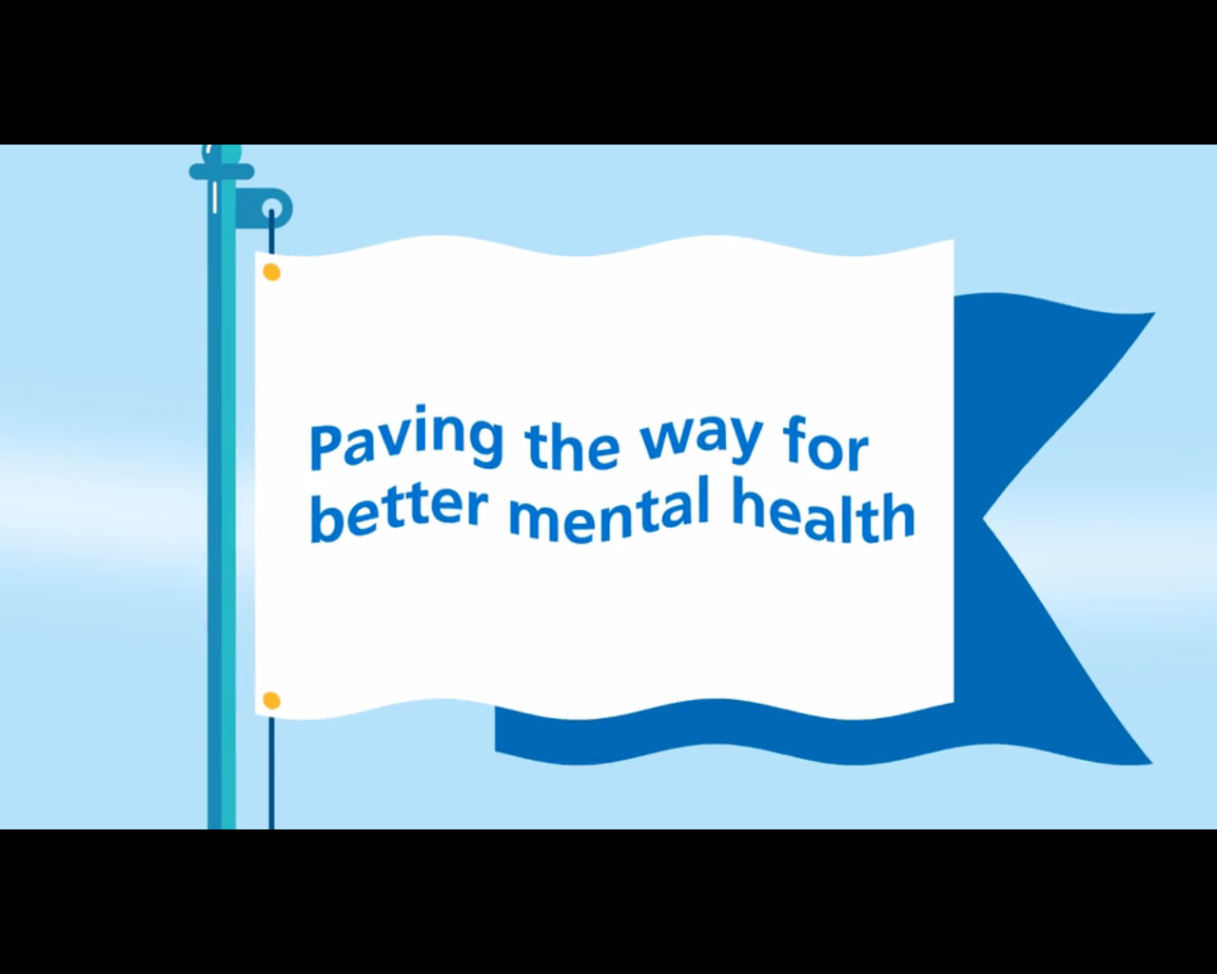
MindMate Lessons

